Slide 1


BVRIT HYDERABAD College of Engineering for Women Department of Computer Science and Engineering
Novel stock prediction for Indian stock market using Ensemble techniques
28th April, 2023
Team No : 22
G. Priyanka : 19WH1A0594
M. Yogitha : 19WH1A05B1
Sai Teasmitha : 19WH1A05B4
Under the Guidance of:
Name: Ms Shanmuga Sundari
Designation: Assistant Professor

Slide 2
TABLE OF CONTENTS
Abstract
Introduction
Literature Survey
Existing system
Objective
Proposed system
Architecture
Methodology
Evaluation metrics
Dataset
Results
Societal impact
Conclusion and Future work
References

Slide 3
ABSTRACT
Stock market price data is generated in huge volume and it changes every second. Stock market is a complex and challenging system where people will either gain money or lose their entire life savings. In this work, an attempt is made for prediction of stock market trend. Novel stock price prediction on Indian market using algorithms Deep Neural Networks and XGBoost with measured accuracy in terms of RMSE. We would be using LSTM followed by Ensemble techniques to predict the stock market price on Indian stock market dataset.

Slide 4
INTRODUCTION
Stock Market Prediction is an example of time-series forecasting that promptly examines previous data and estimates future data values.
It is the act of trying to determine the future value of a company stock or other financial instrument on an exchange.
The stock price crisis is nothing but a significant drop in stock price within a few days due to heavy selling in stocks.
Stock crisis prediction helps investors to exit the market at the right time.

Slide 5
INTRODUCTION
A deep neural network (DNN) is an ANN with multiple hidden layers between the input and output layers. We have an input, an output, and a flow of sequential data in a deep network.
Deep neural networks (DNNs) combine the advantages of deep learning (DL) and neural networks and can be used to solve nonlinear problems more satisfactorily compared to conventional machine learning algorithms.
Ensemble methods is a machine learning technique that combines several base models in order to produce one optimal predictive model.
Results obtained using ensemble committee and those using other approaches would show that the ensemble approach has a lower error rate and generates fewer but compact rules.
Long Short Term Memory (LSTM) networks are a type of Recurrent Neural Network that can learn order dependence.

Slide 6
LITERATURE SURVEY
S.No | Title of the paper | Author(s) & Journal Details | Description/ Interpretation
1. | A Machine Learning-Based Early Warning System for the Housing and Stock Markets | Doojin Ryu, Daehyeon Park, IEEE Access (Volume 9), 06 May 2021 | This study proposes an early warning system for risks of the housing markets due to occurrence of housing bubbles. Future work - Since the predictive power of this EWS is vulnerable to drastic policy changes, further extension of the model to include policy and macroeconomic variables may be necessary for future studies.
2. | Asymmetric Risk Spillovers Between China and ASEAN Stock Markets | Jiusheng Chen, Xianning Wang, IEEE Access (Volume 9), 14 October 2021 | It is used to detect whether there are any risk spillovers between any countries to avoid the stock market downturns. Future work - research, we may include more risk spillover effect models and volatility models and consider whether different models can affect the results.
3. | Decision Fusion for Stock Market Prediction: A Systematic Review | Cheng Zhang, Nilam N. A. Sjarif, Roslina B. Ibrahim, IEEE Access (Volume 10), 01 August 2022 | This study represents how to provide different forecasts of a model having different structures for predicting the stock market prices. Future work - Developing an ensemble with base learners using other algorithms, such as the jump-diffusion model, generative adversarial network (GAN), graph neural network (GNN), and capsule network, can be a future direction for researchers.
4. | Deep Reinforcement Learning Approach for Trading Automation in the Stock Market | TAYLAN KABBANI AND EKREM DUMAN, IEEE Access Volume 10, 2022 | The automation of profit generation in the stock market is possible using DRL, by combining the financial assets price "prediction" step and the "allocation" step of the portfolio to make optimal decisions through trial and error. Future work - The approach 788 can be improved in future work by having more compu789 tational power to run more experiences and better evaluate 790 the approach.

Slide 7
LITERATURE SURVEY
S.No | Title of the paper | Author(s) & Journal Details | Description/ Interpretation
5. | Manipulator Detection in Cryptocurrency Markets Based on Forecasting Anomalies | FIRAT AKBA 1, IHSAN TOLGA MEDENI2 , MEHMET SERDAR GUZEL 1 , AND IMAN ASKERZADE 1, IEEE Access ( Volume: 9), 30 July 2021 | It is possible to have some knowledge of the situations experienced in the markets and to make a profit. Future work - It is believed that this involves one of the most comprehensive research in terms of presenting scientific and realistic solutions about Manipulator detection in Bitcoin Market. This study has the potential to provide a roadmap for further studies.
6. | Market Making Strategy Optimization Via Deep Reinforcement Learning | TIANYUAN SUN , DECHUN HUANG, AND JIE YU, IEEE Access ( Volume: 10), 14 January 2022 | It exploits long short-term memory network to extract temporal patterns of the market directly from limit order books the market making agent according to the inventory states. Future work - DRLMM can be extended to a multi-agent setting, where many agents with different parameters are trained to learn market making and a meta-learning mechanism
7. | Novel Stock Crisis Prediction Technique—A Study on Indian Stock Market | NAGARAJ NAIK AND BIJU R. MOHAN, IEEE Access ( Volume: 10), 14 June 2021 | Stock crisis prediction is a difficult task due to more volatility in the stock market. Future work - different fundamentals stock and technical parameters can be applied to improve the model accuracy.
8. | ML-GATA: A Multilevel Graph Attention Model for Stock Prediction | KUN HUANG 1 , XIAOMING LI 2 , FANGYUAN LIU 3 , XIAOPING YANG 2 , AND WEI YU2, IEEE Access ( Volume: 10), 16 August 2022 | Stock market volatility research has long been the focus of industry and academia, and stock trend forecasting is challenging. We will explore different coding tools suitable for different characteristics in the financial field,

Slide 8
LITERATURE SURVEY
S.No | Title of the paper | Author(s) & Journal Details | Description/ Interpretation
9. | One Step Ahead: A Framework for Detecting Unexpected Incidents and Predicting the Stock Markets | Ziye Lei , Shiwei Lyu, Haipeng Zhang , Tianpai Jiang, IEEE Access ( Volume: 9), 12 February 2021 | It is crucial to quantify the key facts that affect the incidents' impacts, and to estimate the reactions of the markets accurately. Future work - We can predict the impacts of more categories of incidents such as natural disasters and disease outbreaks in more regions.
10. | Optimal Setting for Hurst Index Estimation and Its Application in Chinese Stock Market | Liang Ding ,Yi luo ,Yan Lin,Yirong Huang, IEEE Access (Volume 9), 17 June 2021 | The results show that the settings have significant impact on the accuracy of the Hurst index estimation. Future work - Whether characteristics such as trends, structural breaks, and heavy-tails have an impact on the H index estimation and how to deal with them are fields worthy of future research.
11. | Stock Price Manipulation Detection Using Deep Unsupervised Learning: The Case of Thailand | Teema Leangarun, Poj Tangamchit SuttipongThajchayapong, IEEE Access (Volume 9), 26 July 2021 | The majority of the related work employed supervised learning techniques, which necessitated known manipulation patterns as examples for their models to recognize. Future work - If new incoming trading data show significant deviations from the norm, retrain the models and re-adjust their threshold values to find the best decision boundaries.
12. | Reducing Manual Effort to Label Stock Market Data by Applying a Metaheuristic Search: A Case Study From the Saudi Stock Market | Mohammad Alsulmi, IEEE Access (Volume 9), 02 August 2021 | The results of empirical experiments are practical as it outperforms the current manual approaches for stock data labeling and achieves higher labelling effectiveness. Future work – The limitation whether the improvement in labeling effectiveness will correlate into higher prediction accuracy should be addressed.

Slide 9
EXISTING SYSTEM
Base Paper Link
Base Paper title: Novel Stock Crisis Prediction Technique—A Study on Indian Stock Market.
The existing system for predicting the stock market prices on Indian stock market is developed by using Deep Neural Networks and XGBoost.
DNN is a deep learning algorithm that consists of multiple layers of interconnected nodes. DNN can learn complex nonlinear relationships between input features and output values, making it well-suited for predicting stock prices.
In order to determine if the stock price has climbed or decreased, Deep Neural Networks provide stock price directions.
XGBoost can be used to build ensemble models by combining multiple weak learners, such as decision trees, to improve the overall prediction accuracy.

Slide 10
DRAWBACKS
Lack of research in the Indian stock market
Selection of appropriate features
Data quality and availability
Interpretability of the models

Slide 11
OBJECTIVE
In the current emerging competitive market, predicting the stock returns as well as the company's financial status in advance will provide more benefits for the investors in order to invest confidently. Stock prediction can be done by using the Deep Neural Network because it provides the stock price directions for explaining whether the stock price has increased or decreased.

Slide 12
PROPOSED SYSTEM
To improve the performance of the model, the proposed system forecasts the stock market price using LSTM followed by Ensemble techniques.
LSTM can capture the complex patterns and dependencies in the time series data, while the ensemble techniques can improve the overall prediction accuracy by combining the predictions of multiple models.
By combining LSTM with ensemble techniques, we can leverage the strengths of both approaches and create a more accurate and robust model for predicting stock prices.

Slide 13
ARCHITECTURE
Input
Data Preprocessing
Training and Testing Data
LSTM
SVM
Naïve Bayes Classifier
Bagging
Decision Tree Classifier
Model Evaluation
Output

Slide 14
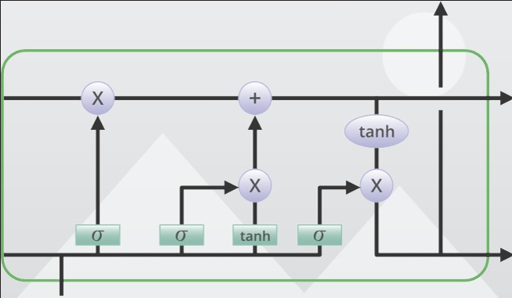
METHODOLOGY
Long short-term memory (LSTM)

Slide 15
METHODOLOGY
Long Short-Term Memory (LSTM) is a type of recurrent neural network (RNN) architecture that is widely used in deep learning for processing sequential data.
The key feature of LSTMs is the use of memory cells and gates, which allow the model to selectively learn and forget information over time.
There are three types of gates in LSTMs: input gates, output gates, and forget gates.
The LSTM architecture has proven to be effective in a wide range of applications, including natural language processing, speech recognition, image captioning, and time series analysis.
In stock prediction, LSTMs can capture the complex patterns and dependencies in the time series data, which are essential for accurate forecasting.

Slide 16
METHODOLOGY
Ensemble methods are a type of machine learning technique that combine multiple models to improve the prediction accuracy and reduce the risk of overfitting.
The idea behind ensemble methods is to leverage the diversity and complementary strengths of multiple models to make more accurate predictions than any individual model.
Ensemble approaches come in a variety of forms, including bagging, boosting, and stacking.
Ensemble methods can be applied to a wide range of machine learning problems, including classification, regression, and clustering.

Slide 17
METHODOLOGY
Support Vector Machines (SVMs) are a type of supervised machine learning algorithm that can be used for classification or regression tasks.
The goal of SVMs is to find the optimal hyperplane that separates the classes in the data with the largest possible margin.
Decision Tree Classifier is a supervised machine learning algorithm that is commonly used for classification tasks.
It works by recursively splitting the input data into subsets based on the values of the input features, until a stopping criterion is reached.
Naive Bayes Classifier is a type of supervised machine learning algorithm that is commonly used for classification tasks. It is based on Bayes' theorem, which is a probabilistic framework for making predictions based on prior knowledge and evidence.

Slide 18
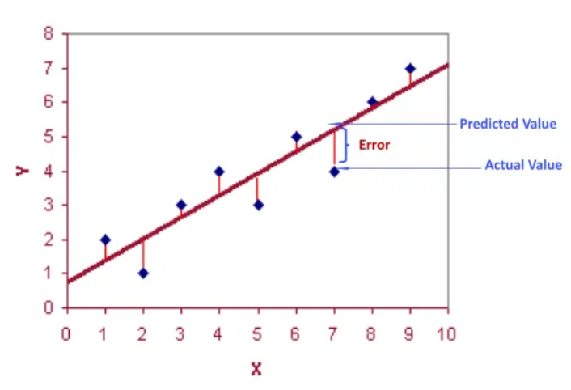
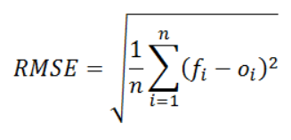
EVALUATION METRICS
Root-Mean-Square-Error(RMSE)
While training regression or time series models, RMSE is one of the most widely used metrics to gauge how accurately our forecasting model predicts values compared to real or observed values.

Slide 19
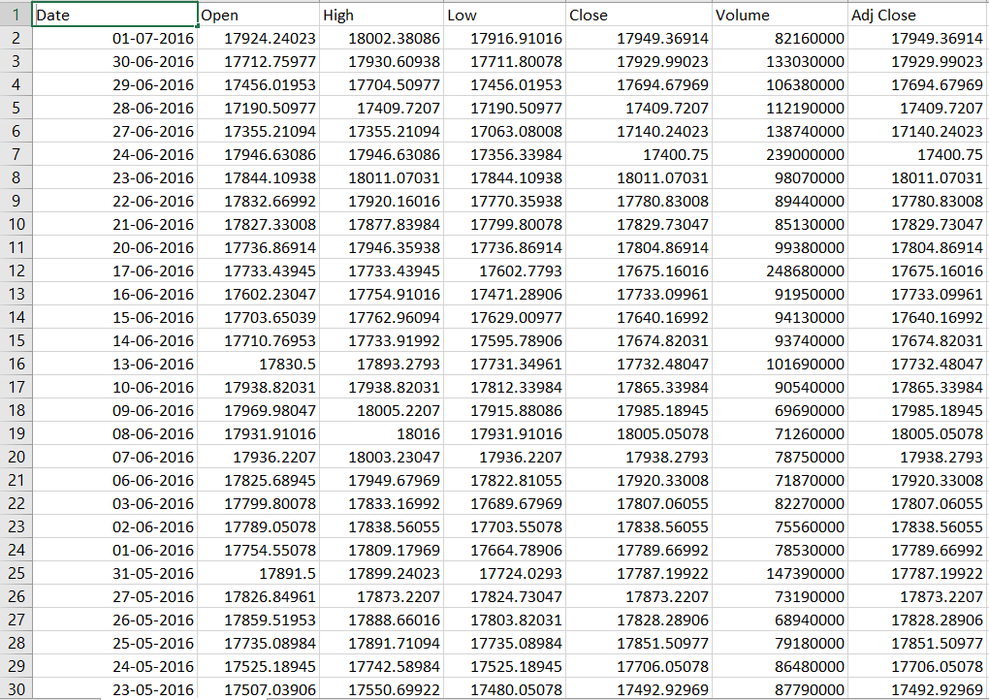
DATASET
No of attributes: 7
Dataset Link

Slide 20
RESULTS
Algorithms | RMSE
LSTM | 0.33495
SVM | 0.10055
Decision Tree Classifier | 0.15851
Naïve Bayes Classifier | 0.30899
Bagging Classifier | 0.10025

Slide 21
SOCIETAL IMPACT
Stock market forecasting seeks to forecast future changes in a financial exchange's stock value.
The majority of researchers in this field are fundamentally motivated by market prediction, which presents excellent profit margins.
A stock's future price prediction that is accurate could result in a sizable profit.

Slide 22
CONCLUSION AND FUTURE WORK
In this study, we proposed a novel stock prediction model for the Indian stock market using ensemble techniques that combine deep learning and machine learning approaches.
We used an LSTM model to capture the complex patterns and dependencies in the time series data and applied ensemble techniques to improve the prediction accuracy.
Transfer learning approaches have shown promising results in various deep learning applications.
The proposed model could be extended to other financial markets beyond the Indian stock market.

Slide 23
PUBLICATIONS
G. Priyanka, M.Yogitha, Sai Teasmitha presented a paper "Novel stock prediction for Indian stock market using Ensemble techniques" on Eighth International Conference on Computing, Communication and Security (ICCCS 2023) at Bathinda, Punjab 03-04 March 2023.
Publication will be in reputed Scopus/ESCI/SCIE Indexed Journals

Slide 24
REFERENCES
[1] Daehyeon Park and Doojin Ryu, “A Machine Learning-Based Early Warning System for the Housing and Stock Markets”, Apr.2021.
[2] Jiusheng Chen and Xianning Wang, “Asymmetric Risk Spillovers Between China and ASEAN Stock Markets”, Oct.2021.
[3] Cheng Zhang, Nilam N. A. Sjarif, and Roslina B. Ibrahim, “Decision Fusion for Stock Market Prediction: A Systematic Review”, Jul.2022.
[4] Taylan Kabbani And Ekrem Duman, ” Deep Reinforcement Learning Approach for Trading Automation in the Stock Market,” Aug.2022
[5] Saud S. Alotaibi,” Ensemble Technique With Optimal Feature Selection for Saudi Stock Market Prediction: A Novel Hybrid Red Deer-Grey Algorithm”, Apr.2021.
[6]Firat Akba, Ihsan Tolga Medeni , Mehmet Serdar Guzel and Iman Askerzade,” Manipulator Detection in Cryptocurrency Markets Based on Forecasting Anomalies”, Jul.2021.
[7] Nagaraj Naik and Biju R. Mohan, “Novel Stock Crisis Prediction Technique—A Study on Indian Stock Market”, Jun. 2021.
[8] Tianyuan sun , Dechun Huang, and Jie Yu, “Market Making Strategy Optimization via Deep Reinforcement Learning”, Jan.2021.

Slide 25
REFERENCES
[9] Kun Huang, Xiaoming Li, Fangyuan Liu, Xiaoping Yang, and Wei Yu, “ML-GAT:A Multilevel Graph Attention Model for Stock Prediction”, Aug.2022.
[10] Yaohu Lin, Shancun Liu, Haijun Yang, (Member, IEEE),Harris Wu,” Stock Trend Prediction Using Candlestick Charting and Ensemble Machine Learning Techniques With a Novelty Feature Engineering Scheme”, July 23, 2021.
[11] Ziyue li , Shiwei Lyu , Haipeng Zhang , (Member, IEEE), AND Tianpai Jiang, ‘‘One Step Ahead: A Framework for Detecting Unexpected Incidents and Predicting the Stock Markets’’, February 25, 2021.
[12] Liang Ding , Yi Luo, Yan Lin , Yirong Huang, ‘‘Optimal Setting for Hurst Index Estimation and Its Application in Chinese Stock Market’’, July 7, 2021 .
[13] Teema Leangarun , (Graduate Student Member, IEEE), Poj Tangamchit , (Member, IEEE), Suttipong Thajchayapong , (Member, IEEE), ‘‘Stock Price Manipulation Detection Using Deep Unsupervised Learning: The Case of Thailand’’, August 5, 2021.
[14] Mohammad Alsumi, “Reducing Manual Effort to Label Stock Market Data by Applying a Metaheuristic Search: A Case Study From the Saudi Stock Market “ , August 12, 2021.
[15] Yao-Hsin Chou , (Member, IEEE), Yun-Ting Lai , Yu-Chi Jiang 2 , Shu-Yu Kuo, “Using Trend Ratio and GNQTS to Assess Portfolio Performance in the U.S. Stock Market” , June 28, 2021.

Slide 26
THANK YOU

